Slide 1
Open Sesame
Micheal Hatch & Philip Vickers

Slide 2
AGENDA
Introduction
Primary goals
Schedule
Project Requirements
Architecture and Design
Website
Questions

Slide 3
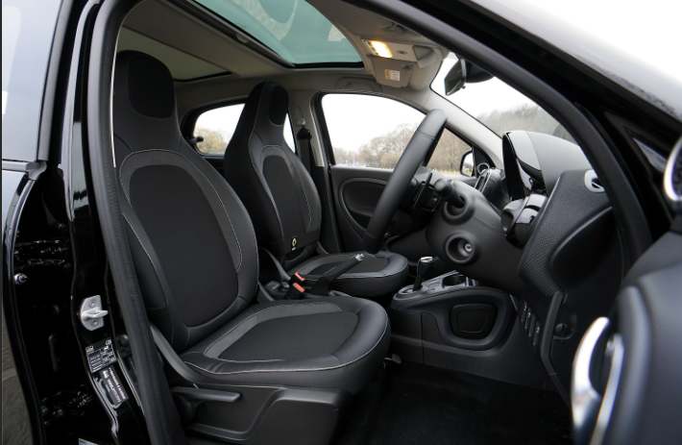
INTRODUCTION
How many times have you wished you had an extra hand when getting into your car? Well, wish no longer with Open Sesame. A voice activated App that opens and closes your car door for you.

Slide 4

PRIMARY GOALS
Hands Free Operation
Communication between App and Vehicle
Safety Features

Slide 5
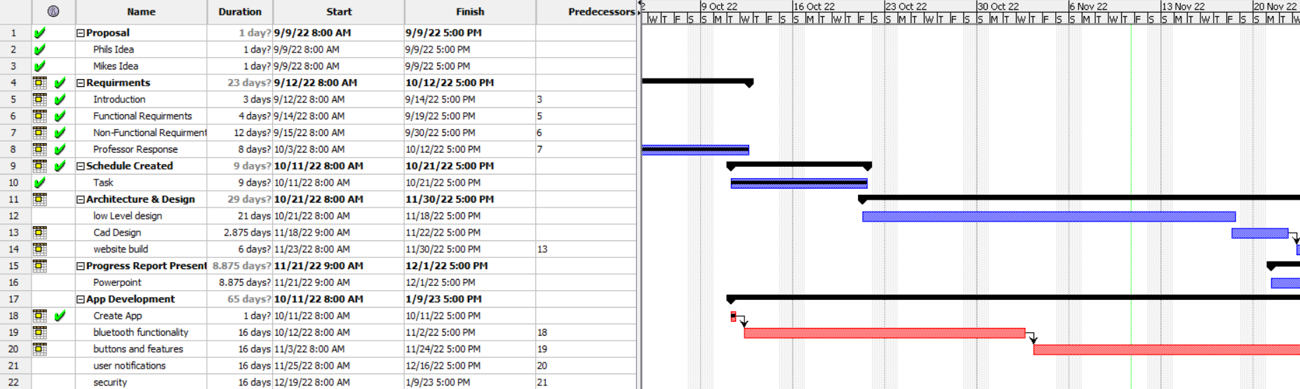
Schedule
On Track
Not a linear project

Slide 6
Project Requirements
Functional Requirements​ | User Action | Product Action | Safety Conditions | Project Requirement meet.
Door Opens using handheld device. | The user says, "Open the right front door." | A blue tooth signal is transmitted to the car and the computer opens the right front door. | Parking Brake must be applied. Car must be parked. | Yes
Door Closes using handheld device. | The user says, “Close the right front door." | A blue tooth signal is transmitted to the car and the computer opens the right front door. | Parking Brake must be applied. Car must be parked. | Yes
Door Blocked while opening. | Determine what obstruction is present and remove it if necessary. | Upon removing the blocking item and ensuring all safety measures have been implemented. | Object is removed, parking brake applied. | Yes
Door Blocked while closing. | Determine what obstruction is present and remove it if necessary. | Upon removing the blocking item and ensuring all safety measures have been implemented. | Object is removed, parking brake applied. | Yes

Slide 7
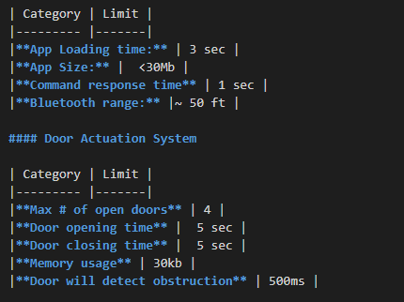
Project Non-Functional Requirements
Platform: Mobile App: Only Android OS
Hardware system: Arduino Uno development board
Performance:

Slide 8
Security: User name and password, Bluetooth pairing pin
User characteristics:
The app must load quickly and after a brief splash screen the app needs to be ready to use.
2. Once on the main screen one button press should set the app in a state to receive voice commands.
3. If a valid command is issued then no further user action should be required to open or close a door.
4. If an error or safety stoppage occurs then the app should clearly communicate the nature of the failure to the user.
5. A home screen widget may be developed to further usability.

Slide 9
Data Formats:
Mobile app input methods will consist of both voice commands and button presses.
The app will connect with the development board via Bluetooth. Bluetooth 2.0 will be
used.
The development board will connect to 4 servos that opens individual doors. The 4 servos
Will use the PWM pins on the dev board.
Internationalization:
Open Sesame will only support English at this time.
Environment: This prototype will only be subjected to indoor climate controlled
environments

Slide 10
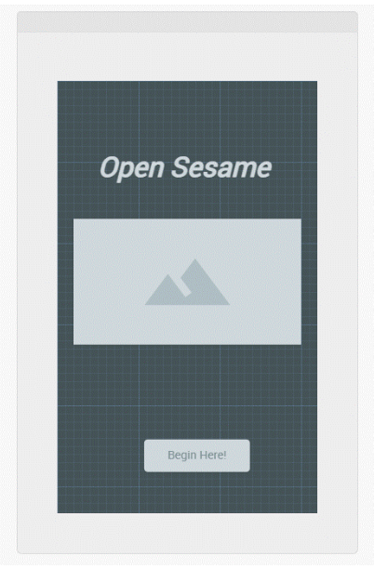
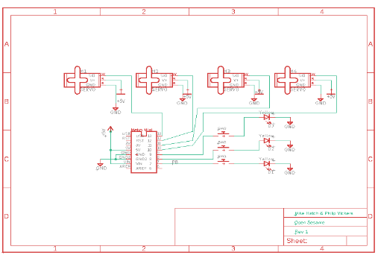
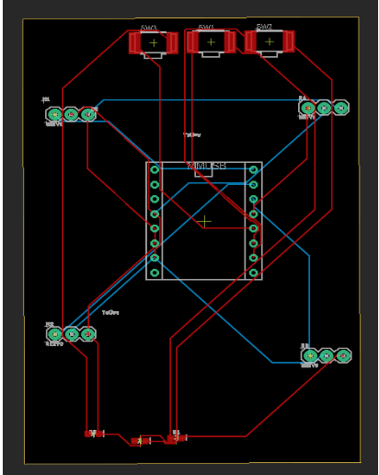
Architecture and Design
User Interface
Schematic
Circuit Board

Slide 11
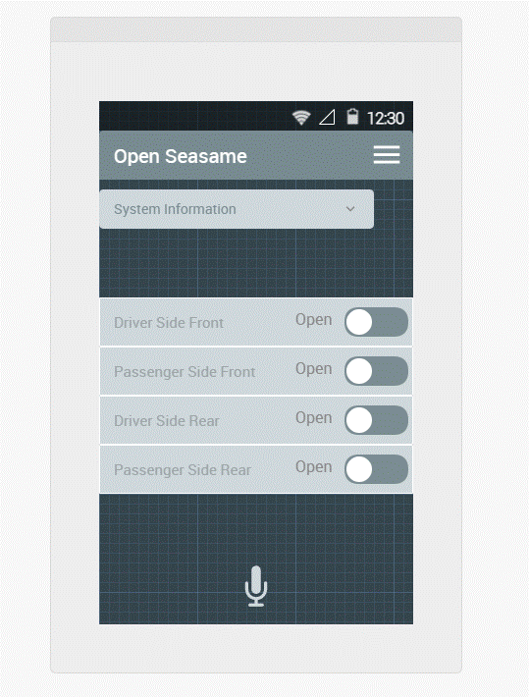
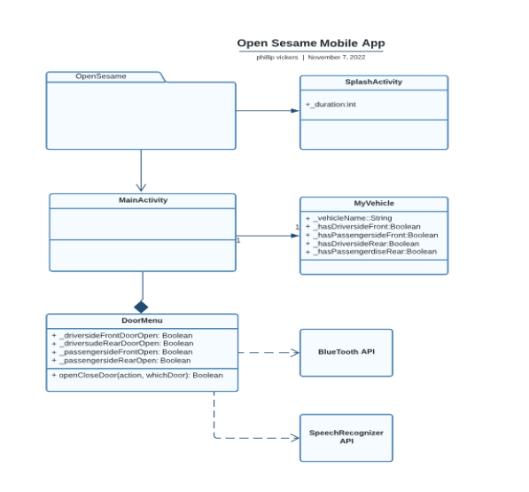
Android App

Slide 12
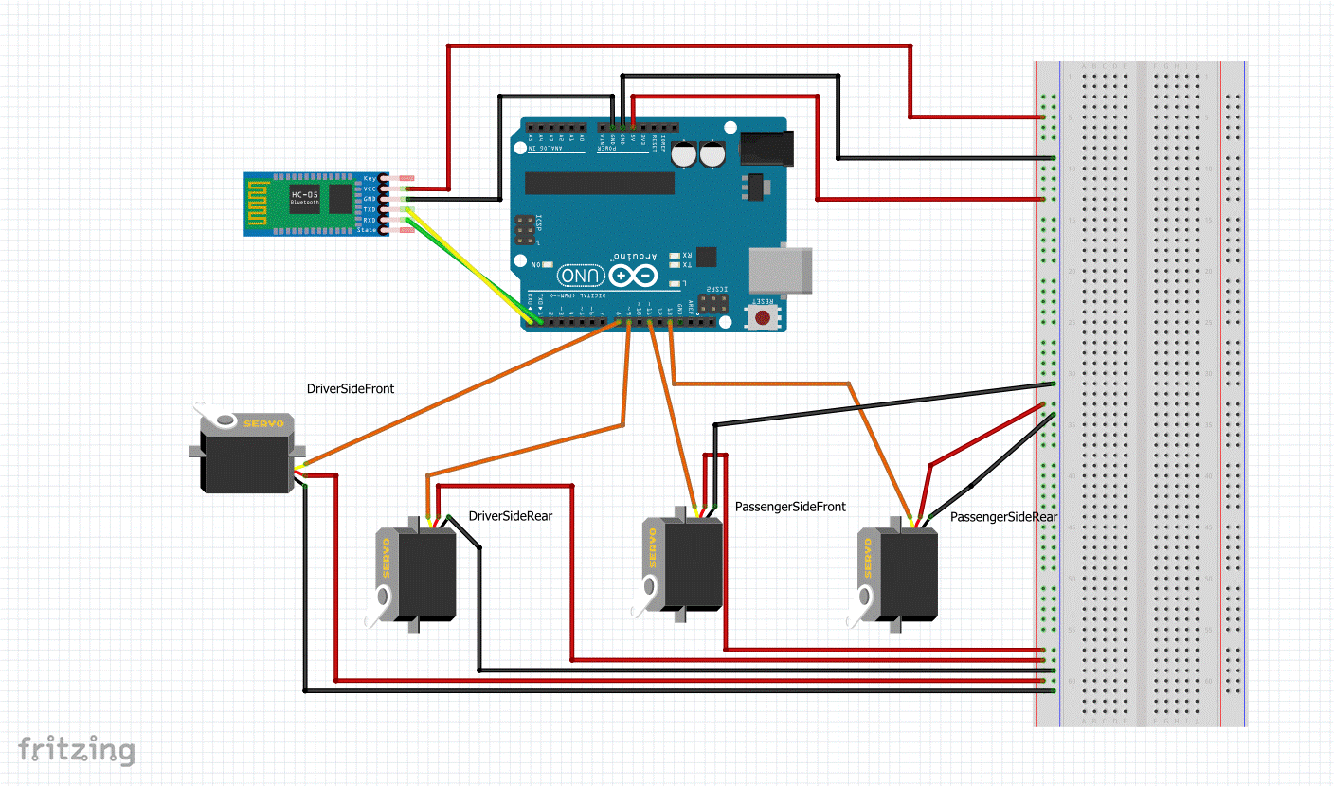
Hardware System
Arduino Uno
4 Servo motor
HC-06 Bluetooth module

Slide 13
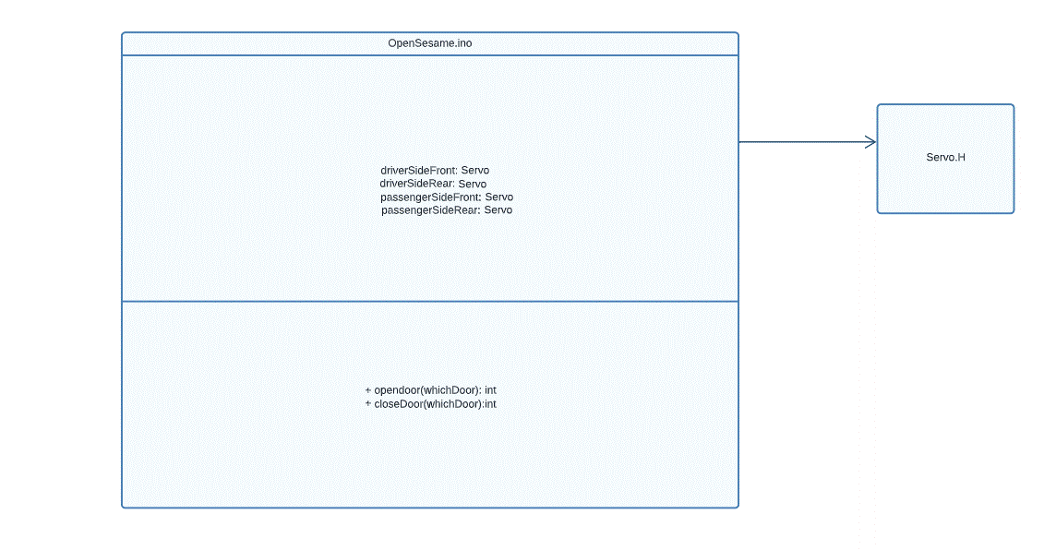
Arduino Code

Slide 14
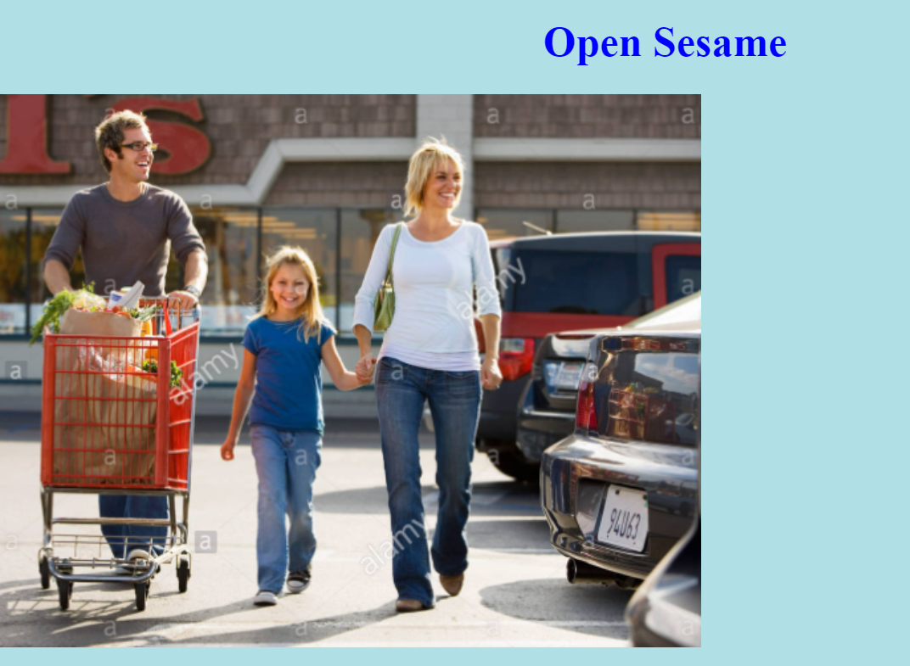
Website
In Process

Slide 15
Any Questions

